Slide 1
Good conflict management
13PE,
HSE 2015
Vadim Andronov
Vladimir Zlobin
Nikita Bakaev
Notes:
{вступление}
https://docs.google.com/document/d/1wgXJZ9kgeuucz1XuDy53rjr0I7yu5nGWbHzPTU4xgbY/edit?usp=sharing

Slide 2
Table of contents
What is conflict
Why is it so important nowadays. Effects
Situations. Win-Win
Best practices
Causes of conflicts
Tips to spoil relationship
Questions
Notes:
____ ПРОСТО ПРОЧИТАТЬ ____
Conflicts are inevitable in working environment, they occurs day to day because of different approaches to issues.
Nevertheless, the way we handle them determines their impact on working process or even the future of the company in the long run.
Misunderstandings may happen between colleagues, foreign partners and between employee and employer.

Slide 3
The conflict is a lack of understanding or a disagreement between the two sides of communication.
What is conflict

Slide 4
Why is it so important.
debates,
swearing,
de-motivation
use of physical force or even murder
staff turnover,
non-productivity

Slide 5
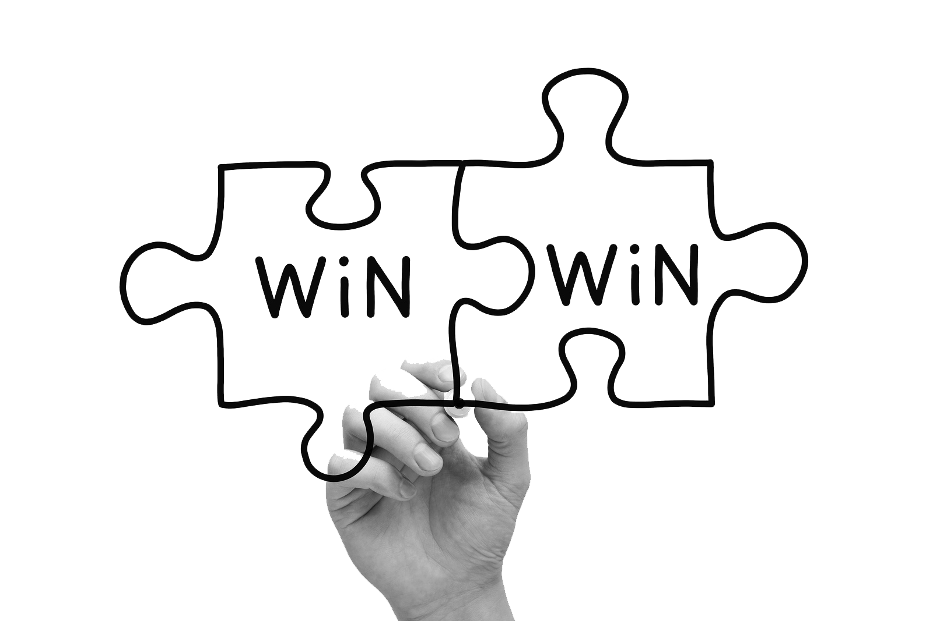
Win-Win
Win-Lose
Lose-Lose
three possible outcomes

Slide 6
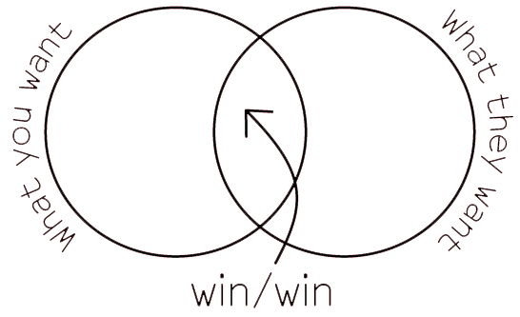
Notes:
Win-Win. This means that both sides successfully found solution that satisfies both.

Slide 7
We will give advices & rules in ~5 slides...
and explain how it can help YOU to reach win-win situation
Notes:
просто прочитать слайд (число 10 - тк просто сказать это число)

Slide 8
What causes conflicts?
Poorly defined goals
Divergent personal values
Lack of cooperation/trust
Competition of scarce resources
Unclear roles/lack of job description

Slide 9
Rules to avoid / alleviating. Part 1/2
Assure privacy
Empathize than sympathize
Listen actively
Maintain equity
Focus on issue, not on personality
Avoid blame
Notes:
Steps to resolve(=alleviating - снижение) conflicts
There is different techniques to handle conflict situations properly and the right one should be chosen depending on the situation. (слова из эссе)

Slide 10
Rules to avoid / alleviating. Part 2/2
Identify key theme
Re-state key theme frequently
Encourage feedback
Identify alternate solutions
Give your positive feedback
Agree on an action plan

Slide 11
- Be judgmental. Think critically
- Send written messages
- Subordinate should come to see me
- Make yourself inaccessible to your team
- Individual Vs team approach
- Not telling them! Not consulting them! And not deciding with them
- Introduce changes without consultation or discussion
- Come tomorrow
Please do not do it
Notes:
Слова при появлении слайда:
1)There are some TIPS to SPOIL conversation. (или примерно так)
2) говорим примеры
3) Заключение: please do not do it { если вы хотите коммуникации/беседы/переговоры без конфликтов }

Slide 12

Respect others, do not quarrel, try to understand other opinion and explore new cultures
the main idea
Notes:
Типо `Соль` - основная мысть всего

Slide 13

No conflicts
#lifewithoutconflicts
Notes:
Шутка ??? скажи конфликтам `нет`, а то много к чему могут привести = давайте жить дружно
….
…. ( Пости в твиттер с хэштегом #lifewithoutconflicts ) - не говорить это

Slide 14
Questions

Slide 15
{{умная мысль}}
{{ умный текст }}...

Slide 16
{} is here.
{}
{}
{}{}{}

Slide 17
Yes, we’ve always had caching… But, we were never able to optimize for “churn” because small requests were too expensive. This is no longer the case.
How expensive are your cache invalidations?
Can you isolate high-velocity code from “stable” code?
Can you assign different expiry times to these resources?
* churn: ratio of bytes (in cache vs new) we have to fetch when pushing an update.

Slide 18
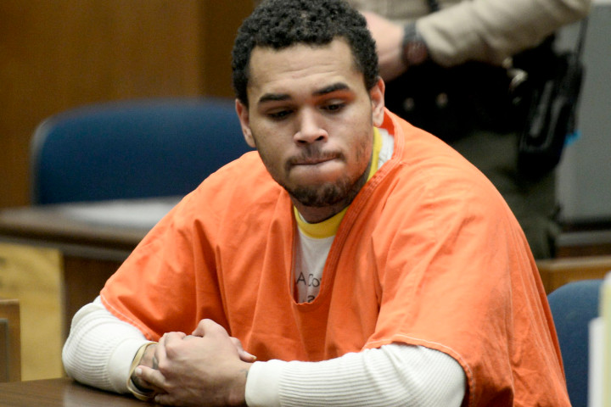
No conflicts
#lifewithoutconflicts
Notes:
Шутка ??? скажи конфликтам `нет`, а то много к чему могут привести = давайте жить дружно
….
…. ( Пости в твиттер с хэштегом #lifewithoutconflicts ) - не говорить это

